Slide 1


Slide 2


Slide 3
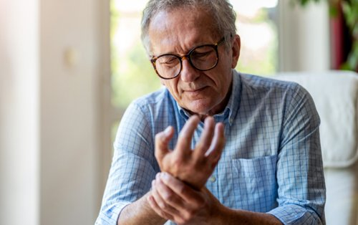
Aging changes of the Musculoskeletal System
Prepared by :
Bandana Tiwari
Roll no: 6
BNS 2nd year

Slide 4
General Objectives
At the end of the classroom session, BNS 1st year students will be able to explain about physiological changes in musculoskeletal system and pathological fractures.

Slide 5
Specific Objectives
At the end of this teaching session, the BNS 1st year students will be able to:
state the age related changes in musculoskeletal system.
list the common health problems in musculoskeletal system.
define pathological fractures.

Slide 6
enlist the causes of pathological fractures.
list the sign and symptoms of pathological fractures.
enlist the diagnostic investigation of pathological fractures.
explain the treatment procedure of pathological fractures.
explain the nursing management of pathological fracture.
list the complication of pathological fracture.
explain the prevention of pathological fracture.

Slide 7

Age related changes in musculoskeletal system

Slide 8
Physiological changes in musculoskeletal system
Changes in muscle:
As muscle age they begin to shrink and loss mass.
Muscle tissue is replaced by more slowly and lost muscle tissue is replaced by a tough, fibrous tissue.
Muscle loses size and strength as get older which can contribute to fatigue, weakness and reduced tolerate to exercise.

Slide 9
The heart muscle becomes less able to propel large quantities of blood quickly to the body.
Changes in adult weight also occur in the older adult due to loss of muscle tissue.
Changes in Bone:
Loss of calcium from bone (due to gonadal function after menopause).
Bone density decrease at the rate of 0.5% each year after the third decade of life.

Slide 10
Decrease the synthesis of bone and increased decalcification or osteoporosis in vertebrae.
Changes in joints:
Joint movement becomes stiffer and less flexible because the amount of lubricating fluid inside the joints decrease and cartilage become thinner.
As the cartilage begins to break down from a lifetime of use of joints , become inflamed and arthritic.

Slide 11
Problems in musculoskeletal system
Osteoarthritis
Osteoporosis
Gout
Pathological fracture
Rheumatoid arthritis (RA)

Slide 12
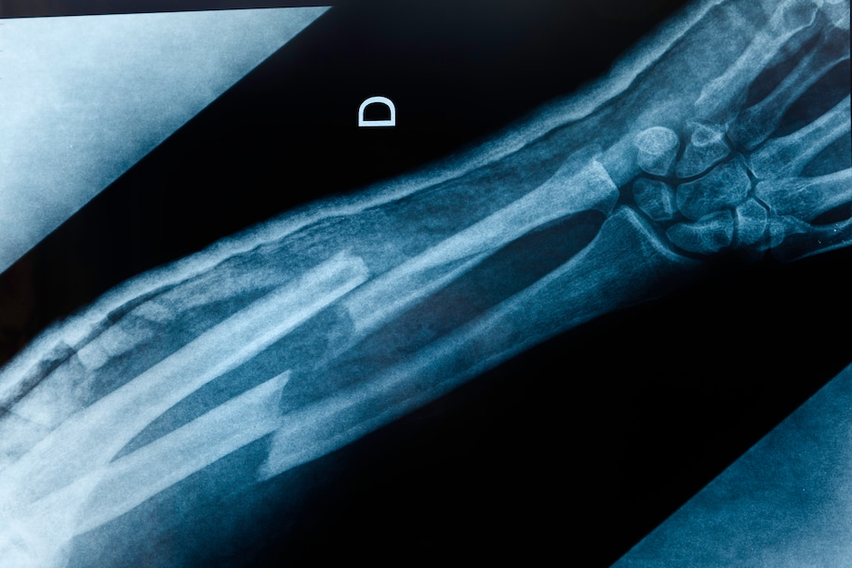
Pathological fractures

Slide 13
Pathological fractures
A type of fracture that is a secondary result of another illness or chronic condition that weakens the bones of the skeletal system.
In another word, pathological fractures is a break in bone that is caused by an underlying disease.

Slide 14
It occur as a result of minimal trauma or event during normal activities.
Many of these patient have multiple fracture, delayed union or non union.
There are many local and generalized skeletal disease that involve breakdown or changes in the bone quality and thus can be the cause of a fracture.
Common sites proximal femur, distal femur, distal radius.

Slide 15
Causes
Osteoporosis ( commonest cause)
Metabolic bone disease
- Rickets
- Osteomalacia
- Treatment with steroid
- Hyperthyroidism
Bone tumor

Slide 16
Infection: osteomyelitis (chronic, tubercular)
Iatrogenic cause : surgical defect

Slide 17
Sign and symptoms
Mild to severe pain near the fracture bone.
Swelling, bleeding
Numbness and tingling
Broken skin with bone protruding
Limited mobility or inability to move affected area

Slide 18
Diagnostic investigation
History taking
Physical examination
X-ray
MRI/ CT scan
Laboratory test: calcium, blood count
Biopsies for tumors

Slide 19
Treatment
Initial treatment
Standard fracture care: reduction and immobilization
Evaluation of underlying pathological process
Optimizing of medical condition

Slide 20
Surgical treatment
Internal fixation with or without cement augmentation
Hemiarthroplasty
Resection and prosthetic reconstruction

Slide 21
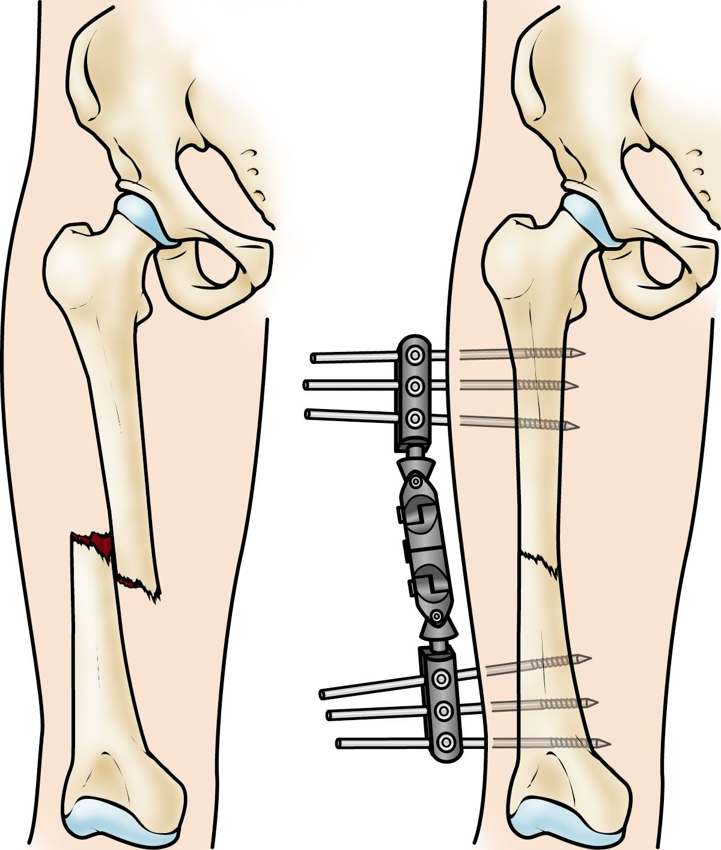
Internal fixation

Slide 22
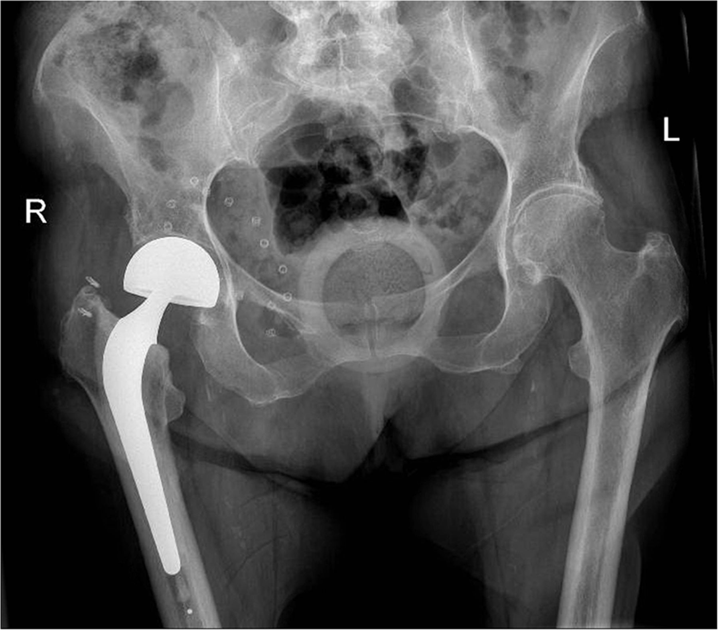
Hemiarthoplasty of the Hip

Slide 23

Nursing Management

Slide 24
Complication
Infection
Hemorrhage
Failure of fixation
Thromboembolic disease
Bone pain

Slide 25
Prevention
Exercise on regular basis to keep your muscle strong and improve bone health.
Use prosthetic or assertive device, such as supportive shoes, walker.
Receive early treatment of underlying condition.
Get enough vitamin D and calcium.
Avoid high intensity exercise.

Slide 26


Slide 27


Slide 28
Summary
What are the physiological changes in musculoskeletal system?
What do you understand about pathological fractures ?
What are the surgical treatment procedure of pathological fractures?

Slide 29
References
Baral, R. Essential of Geriatric Nursing. Makalu publication.
Bruners and Siddharth, Medical Surgical Nursing, 10th edition.
Pradhan , M,K and Roka, A,T. (2015). Gerontological Nursing for BN/BSN Students (1st edition) Vidyarthi Prakashan
Subedi, P,S and Subba, K,H.(2019). A Textbook of Geriatric Nursing.(1st edition ). National Book Center.

Slide 30
Timalsina, R. (2077). Comprehensive Textbook of Geriatric Nursing.(3rd ed). Samiksha publication.
https://www.neurosurgery.Columbia.edu

Slide 31
Home Assignment
Write the physiological changes in musculoskeletal system.
Write short note on pathological fractures.

Slide 32
Plan for next class
We will discuss about osteoarthritis and gout in next class.

Slide 33


